Slide 1

AMS Boys Winter Sports Meeting
2025-26

Slide 2

ANTIGO ATHLETIC PRIDE!
-Have positive experiences, create healthy relationships of encouragement, and for everyone give their best effort all the time!
-Represent Antigo during home and away events displaying good sportsmanship at all times.

Slide 3
Schedules-stay up to date!
You can find the team schedules on the Antigo High School website
https://www.antigo.k12.wi.us/schools/high/
under the Athletics/Activities and click on the Activities Calendar.
The link below will take you right to the activities calendar where you can view schedule, get the mobile app, and subscribe to notify me for to receive automatic text and email notifications for schedule changes and reminders for those activities you want to track.
Antigo

Slide 4
STUDENT ATHLETE ACADEMICS
-SCHOOL COMES FIRST! Every athlete is expected to do their absolute best in each and every class. Teachers are always available there for help.
Grades - MS WINTER SPORTS - Boys 7-8 Basketball will go off of
Semester 2 grades from 24-25 and then Quarter 1 grades.
MS WINTER SPORTS - Gymnastics & Wrestling will go off of Quarter 1
Grades and Semester 1 grades. Quarter 1 ends November 8 and
Semester 1 ends on January 23rd.
2 or more F’s will make the athlete ineligible for the season.
1 F the athlete will be on weekly grade checks.
If they have 1 or more F’s during the weekly grade check, they will be
ineligible to compete until the next grade check. They will not be able
to travel that week to away events but can attend any home events.
They will be able to practice with their team during that week.

Slide 5
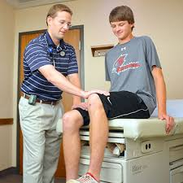
SPORTS PHYSICAL
-Every student athlete needs a sports physical every 2 school years-Fully completed signed and dated by doctor and filled out and signed by a parent/guardian. The original form then needs to be turned into Beth Decker at the high school athletic office. Please make an appointment with your doctor or clinic. You must submit the physical form to the HS Athletic office.

Slide 6
DRIVING AND RIDING FORMS
If an athlete needs to ride home with a parent/guardian after an away competition,
a Ride Home with Parent/Legal Guardian form (green) must be filled out for the sports season and list the authorized parent/guardian to transport them home after the event. This form needs to be completed and returned to Beth Decker or Tom Schofield in the HS Athletic office prior to the start of competition. There will then be a sign out sheet with the Coach for the parent to sign out their child after each event is completed.
**Do not turn them into the coach or turn them in the day of an event.
If your student athlete needs to ride home after an away event with someone other
than their parent/guardian and they are age 21 or older, there is an orange form that needs to be filled out and turned into the HS athletic office to be approved and signed 24 hours prior to the event. For Saturday events, this form would need to be turned in by 9:00 am Friday morning,

Slide 7
BASELINE IMPACT TEST
Below is the date for MIDDLE SCHOOL Sports Baseline testing.
All testing will take place in the high school commons.
Any Student in Grade 7, any 8th grade student that was not in a sport in 2024-25, and any NEW STUDENT ATHLETES.
Wednesday, October 8th at 3:30 pm in the HS Commons for all 7th grade students that were not out for a Fall sport and any 8th grade students that were not out for a sport in 7th grade or this Fall. 6th grade students do not test.
Please contact Beth Decker in the athletic office if you are not sure if your student athlete needs to take the test - bdecker@antigoschools.org or (715) 623-7611 ext. 2100

Slide 8
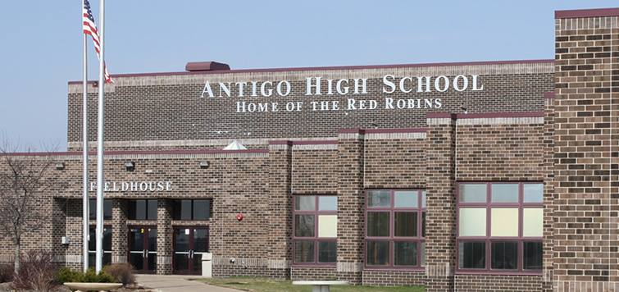
Middle School Athletic Registration
Every athlete must complete the online registration for High School Sports in order to participate. The School Code of Conduct is included in this registration. Please read this over carefully as stated in the previous slide.
Below is the link to Middle School Athletic Registration as well as the directions on how to complete the athletic registration for your
student athlete.
Registration Link

Slide 9
DO WHAT’S RIGHT
-Remember expectations and the bar is set higher for student athletes and their parents/caregivers. Know the code of conduct expectations! We need all coaches, players, and parents/caregivers to represent Antigo athletics in the best way displaying great sportsmanship and attitudes during school, practices, competitions, in the community, everywhere you are!
AMS ATHLETIC CODE

Slide 10
I LOVE TO WATCH YOU PLAY!
Good sportsmanship is key by everyone involved. This powerpoint goes over the expectations of providing support for our programs during a season including spectator expectations at all events.
Antigo athletics need everyone focused on creating a positive environment to ensure our student athletes have wonderful High School memories.
Parent/Guardian/Caregiver Expectations Powerpoint

Slide 11
BOYS WINTER COACHING STAFF
-7th Grade Boys Basketball coach:
Joe Peters
-8th Grade Boys Basketball coach:
Sam McCann and Brent Morris
6th-8th Wrestling coaches:
Jesse Peterson and Steve Desjarlais

